Slide 1
Introduction of 7bnn.
Slide-1
Docking with Famciclovir and 7bnn (Spike Protein).
Molecular
Slide-2-3
Bioinformatics approach. BLAST, Clustal,UPGMA etc.
Docking
Slide-4-5
Slide-6-7
Analysis .dlg and .glg file.
Different drugs of viruses.
Slide-8-9
Slide-10-11
Links and tools/software’s.

Slide 2
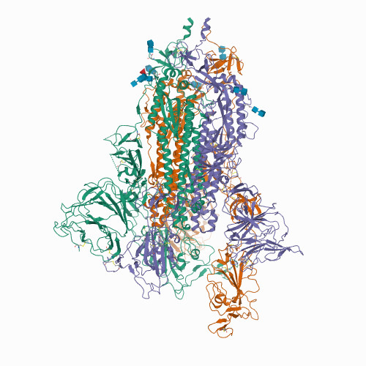
Introduction of 7bnn.
Severe acute respiratory syndrome coronavirus 2)
About 7bnn protein
Organism(s): Severe acute respiratory syndrome coronavirus 2
Open conformation of D614G SARS-CoV-2 spike with 1 Erect RBD
Classification: VIRAL PROTEIN
Expression System: Homo sapiens
7bnn
UNIPROT ID: P0DTC2

Slide 3
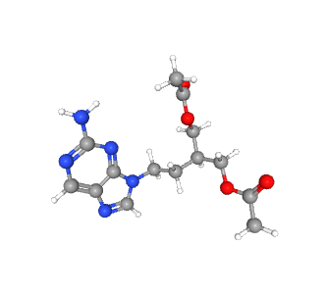
Docking with Famciclovir and 7bnn
AutoDock and Pymol for both protein and lingad.
About Famciclovir
Why Not Others?
Famciclovir is a diacetyl 6-deoxy which act as analog of the antiviral agent.
which is active against the Herpes viruses, including herpes simplex 1 and 2 and varicella-zoster.
Both structure of 3d conformation in .sdf format form pubchem.ncbi.nlm.nhi.gov/
Famciclovir

Slide 4
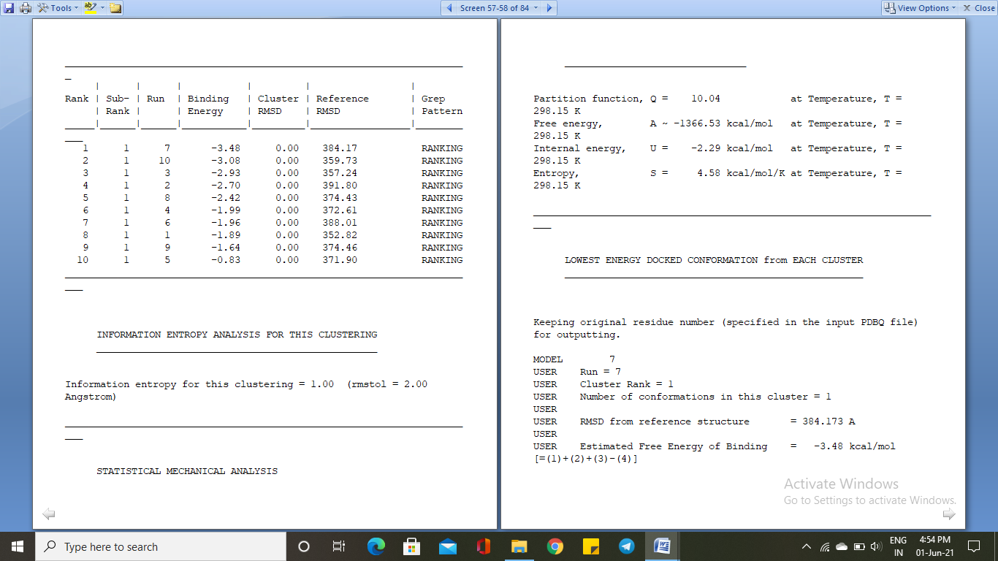
Docking with Famciclovir and 7bnn
Result of docking in .dlg and .dpf file
Binding energy of interaction
Why Not Others?
Estimated Free Energy of Binding = -3.48 kcal/mol
No. of run for this Energy of Binding = 7
Estimated Inhibition Constant, Ki = 2.81 mM (millimolar) at [Temperature = 298.15 K]
As this is computational based inhibition
Constant so, in literature I found that the value may get some extent of fluctuation.

Slide 5
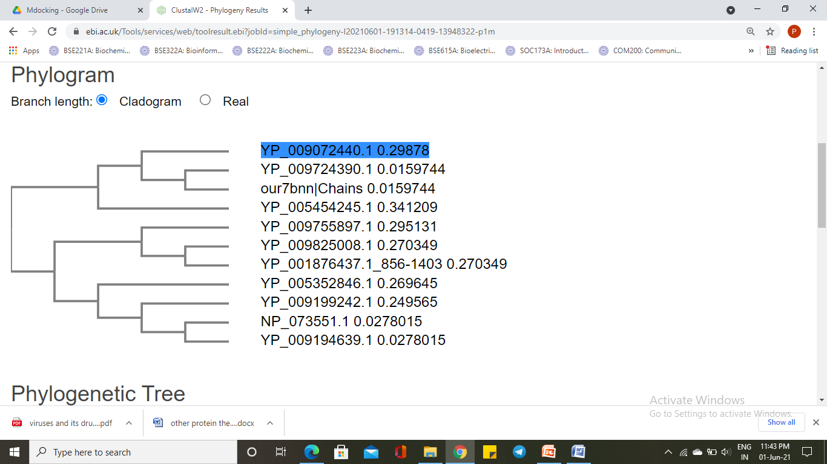
Bioinformatics approach. BLAST, Clustal etc.
For getting idea about the binding pocket
About result in blast and clustal.
When all different spike protein of different organism with fasta sequence align in CLUSTAL Omega for find the most conserved region in the protein
Then in ClustalW2 tool with UPGMA clustering method we found that spike protein of coronavirus 2 were more closer to spike protein[BatHpbetacoronavirus/Zhejiang2013]
Using similar method we can proceed if any unknown virus for hit and trial for the motifs which is more closer to virus.

Slide 6
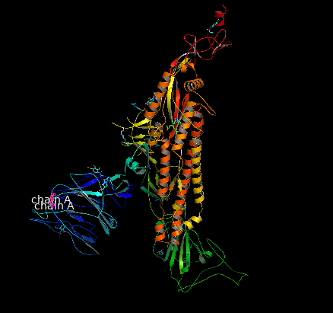
Analysis of results .dlg and .glg file.
Using Autodock, Protein Pluse.
Steps in Proteins Plus
Why Not Others?
.dlg file were converted inside the AutoDock to .pdb file and then in then in pymol .pdbqt file so that we can used in (https://proteins.plus/) for the visualization of different surface area, volume and orientation of the protein and ligand.

Slide 7
Different drugs of viruses.
HIV-1 , HEP-B,HEP-C, Ebola virus
No. | Virus | Name of Drugs | Inhibiting protein/part
1 | HIV-1 | 1.Fostemsavir 2.Rilpivirine in with cabotegravir | inhibits the activity of gp120, a subunit within the HIV-1 gp160 envelope glycoprotein that facilitates the attachment of HIV-1 to host cell CD4 receptors - in doing so, temsavir prevents the first step in the HIV-1 viral lifecycle.
2 | HEP-B | interferon-α, pegylated interferon-α, lamivudine. | Lamivudine(3TC-TP): can act as (i) a chain terminator,with HBV DNA chain, (ii) as a competitive inhibitor of the DNA polymerase. (iii)3TC-TP inhibits viral DNA synthesis,.
3 | HEP-C | 1.telaprevir, boceprevir, asunaprevir, vaniprevir, simeprevir, paritaprevir 2.daclatasvir, ledipasvir, ombitasvir 3.sofosbuvir, dasabuvir | (i) Inhibits: translation and polyprotein processing (ii) Inhibits: replication complex. (iii) Inhibits: replication of viral RNA.
4 | Ebola | Ebanga Inmazeb | 1.Ebanga :blocks binding of the virus to the cell receptor, preventing its entry into the cell. 2. Inmazeb: targets the glycoprotein that is on the surface of Ebola virus. Glycoprote-in attaches to the cell receptor and fuses the viral and host cell membranes allowing the virus to enter the cell.

Slide 8
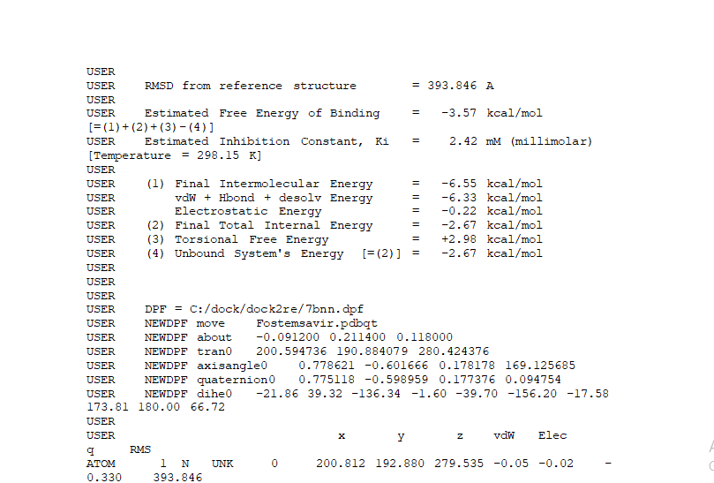
Docking of 7bnn against Fostemsavir
using bio-info. HIV-1 was found more similar to SARS-CoV-2 VIRUS
https://plip-tool.biotec.tu-dresden.de/plip-web/plip/result/d450d867-2b2c-4cd8-aa59-876020d9911b
Estimated Free Energy of Binding = - 3.57 kcal/mol
No. of run for this Energy of Binding = 10
Estimated Inhibition Constant, Ki = 2.42 mM (millimolar) at [Temperature = 298.15 K]
This result was batter then the previous one as inhibition constant decreases and the binding energy increase, because as in multiple sequence alignment HIV-1 was shown more closer to spike protein of SARS-CoV-2.

Slide 9
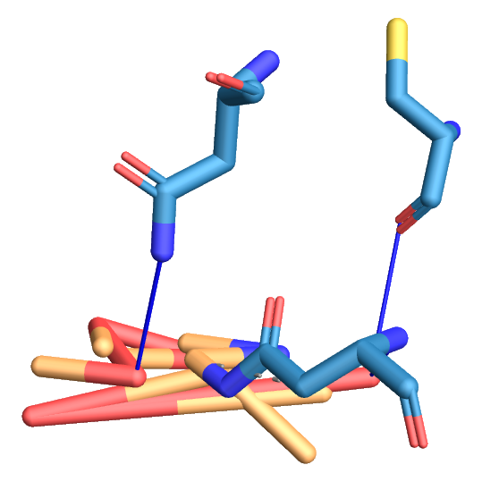
Docking of 7bnn against Fostemsavir
Result analysis with plp
Index | Residue | AA | Distance H-A | Distance D-A | Donor Angle | Protein donor? | Side chain | Donor Atom | Acceptor Atom
1 | 15A | CYS | 2.78 | 3.75 | 172.26 |  |  | 10253 [O3] | 61 [O2]
2 | 17A | ASN | 3.08 | 3.74 | 122.80 |  |  | 73 [Nam] | 10253 [O3]
3 | 137A | ASN | 3.28 | 3.68 | 105.35 |  |  | 1224 [Nam] | 10249 [O3]
Hydrogen bind and residue were obtained, along with distance.
https://plip-tool.biotec.tu-dresden.de/plip-web/plip/result/d450d867-2b2c-4cd8-aa59-876020d9911b

Slide 10
Docking of 7bnn against Fostemsavir
Result analysis with proteins plus
In this protein plus we get some imporatant informations like drug score,
Surface area , volume of pocket, and postion of ligand.
The cordinates of residue CYS -15A, ASN- 17A, ASN-137A (Asparagine, Cysteine ). This was same as we get in the case of bioinformatics multiple sequence alignment in the more conserved region.
The Fostemsavir drugs are being used in HIV-1 virus and U.S. Food and Drug Administration.
https://proteins.plus/bestdockpdb413cf31c-480d-4cb5-afff-2c926c7afd34

Slide 11
Links & tools used
https://www.rcsb.org/structure/7BNN
https://pubchem.ncbi.nlm.nih.gov/compound/3324
Blast, Clustal, UPGMA, pymol, AutoDock.
https://proteins.plus/
Protein-Ligand Interaction Profiler
https://proteins.plus/bestdockpdb413cf31c-480d-4cb5-afff-2c926c7afd34
https://www.fda.gov/news-events/press-announcements/fda-approves-new-hiv-treatment-patients-limited-treatment-options
Praveen Prabhat
IIT Kanpur (BSBE)
Thank you

Slide 12
Docking result of 6lu7 and Boceprevir
Estimated Free Energy of Binding = -8.73 kcal/mol
USER Estimated Inhibition Constant, Ki = 395.71 nM (nanomolar) [Temperature = 298.15 K]

